Slide 1


Team 30: ECEN 215 Lab Kit
Bi-Weekly Update 5 Members: Luis Diaz-Santini, Yusuf Hossain,
Ryan Freed, and Peter Zhang Sponsor: Dr. Lusher
TA: Garret Brown
Notes:
Intro should take 30 seconds

Slide 2
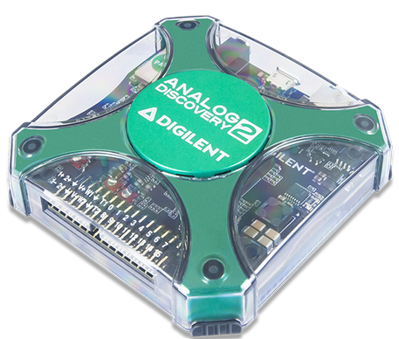
Project Summary
Problem Statement:
Principles of Electrical Engineering (ECEN 215) teaches the basics of electric circuit analysis and electronics to non-ECEN majors.
The transition of ECEN 215 to an online format poses a challenge due to its lab component relying on the Analog Discovery 2 (AD2), which is expensive.
Solution Proposal:
The ECEN 215 Lab Kit offers a solution to the cost, convenience, and over complication issues that are abundant with the AD2. Aiming for a $50 price point, the lab kit offers a more catered simpler approach to each lab while also making it possible to complete at home.
Will operate as the power supply, signal generator, multimeter, and Oscilloscope.

Slide 3
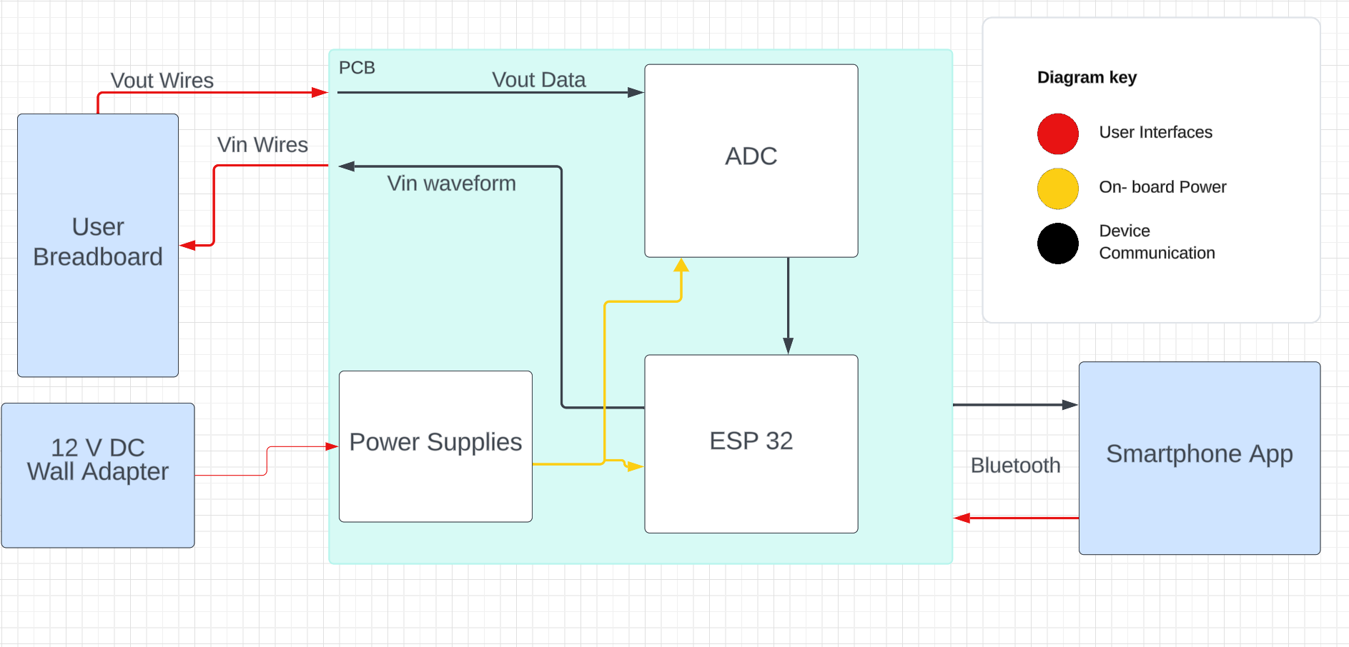
Subsystems Overview
Peter: Multimeter and Oscilloscope
Yusuf: Waveforms and communicating to the microcontroller.
Luis: Mobile application to interface with device
Ryan: PCB design and power.

Slide 4
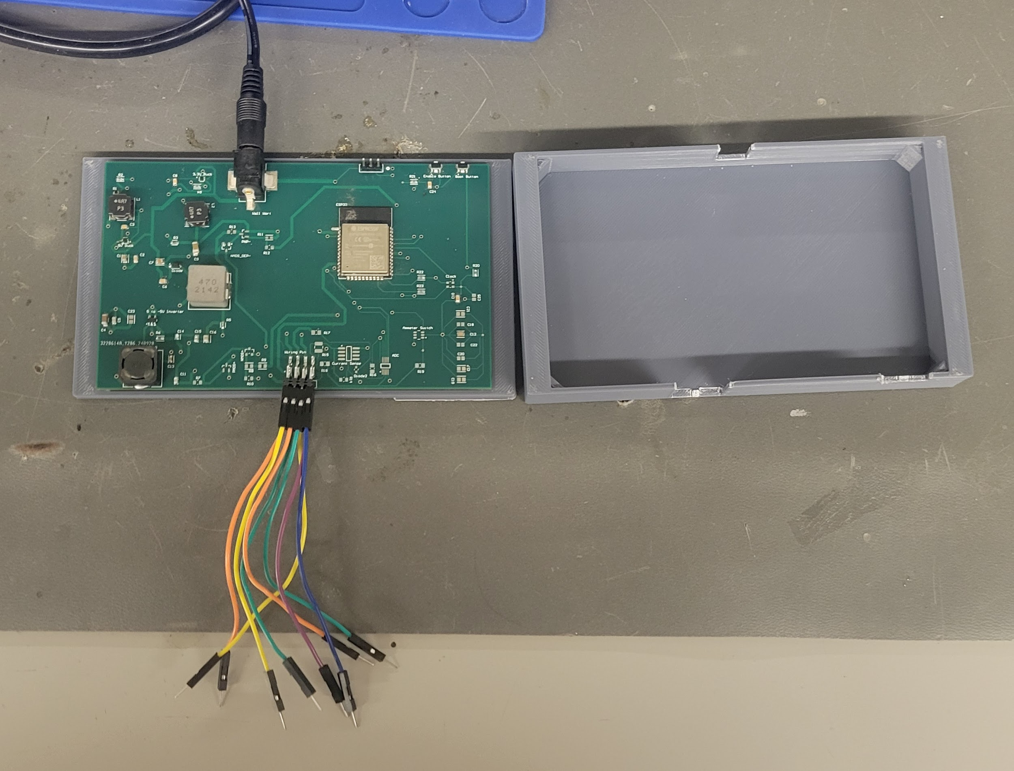
Integrated System Diagram
Pins:
+5 V supply, -5 V supply, GND, Waveform,
Amm+, Amm-, Voltmeter+, Voltmeter-,
(Ohmmeter+,
Ohmmeter-)

Slide 5
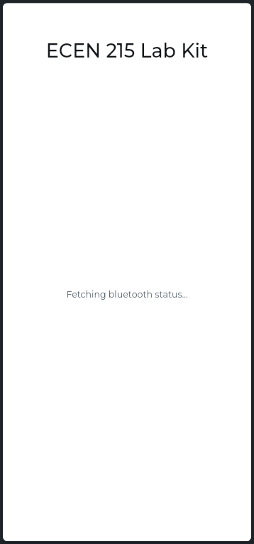
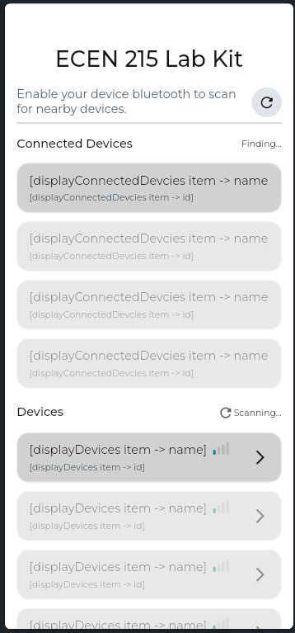
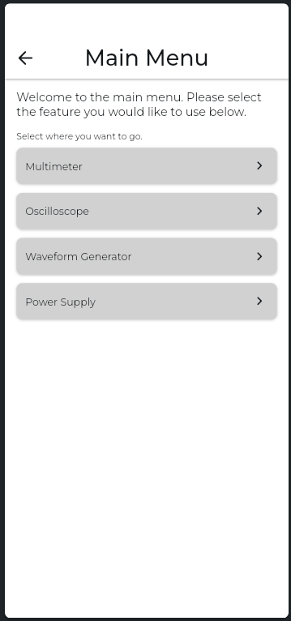
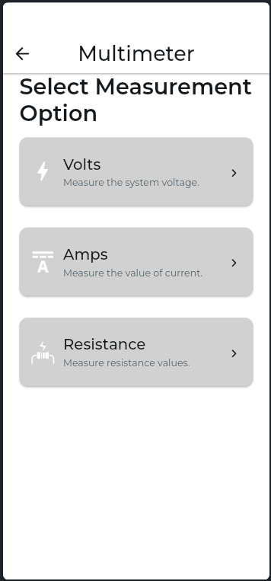
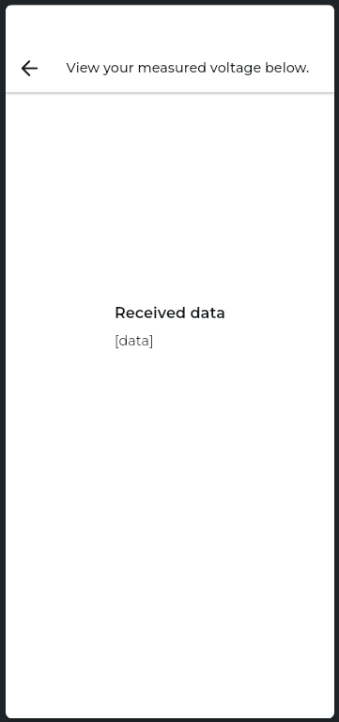
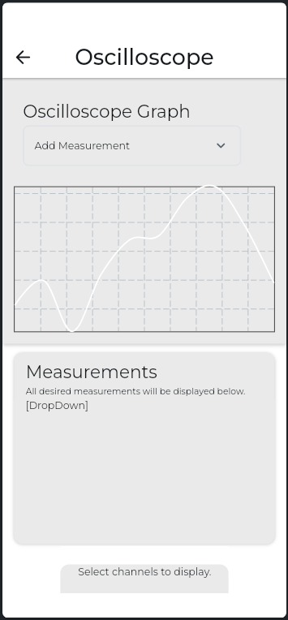
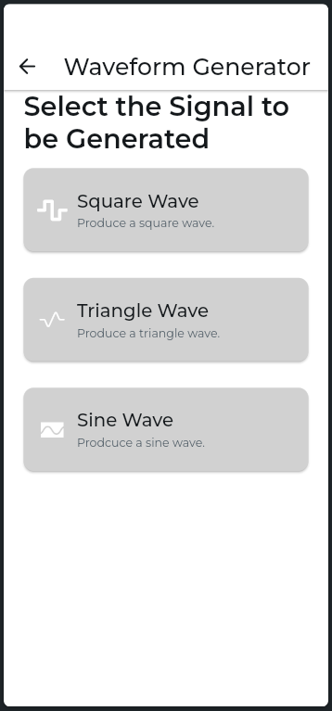
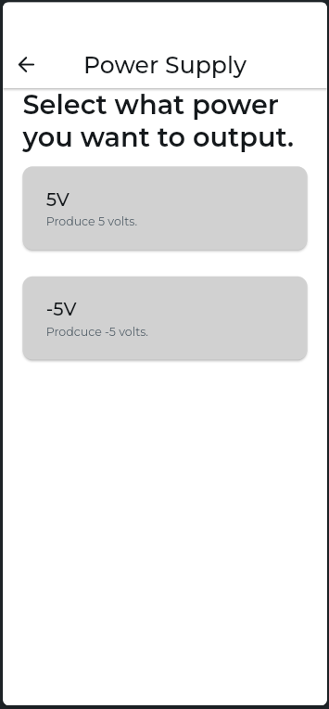
Integrated System Diagram

Slide 6
Project Timeline
Ensure Working Subsystem (completed 8/22) | Research Integrating / Ensure Working Subsystems (completed 8/29) | Integrate App with Wave Gen and Multimeter (to complete by 9/24) | Integrate App with Oscilloscope / Integrated Testing (to complete by 10/16) | Complete Testing of Integrated Subsystems (to complete by 10/30) | Complete Validation of Integrated Subsystem (to complete by 11/7 | Documentation and Buffer Time (to complete by 11/10)

Slide 7
Waveform Generator
Yusuf Hossain
Accomplishments since last update 22 hrs of effort | Ongoing progress/problems and plans until the next presentation
ESP32 can now generate negative voltages using AC coupling Wavegen produces all the required shapes, frequencies and amplitudes | Upload final code onto PCB ESP32 Testing to see what capacitor value produces the smoothest waveform Implement Adjustable parameters on the app

Slide 8
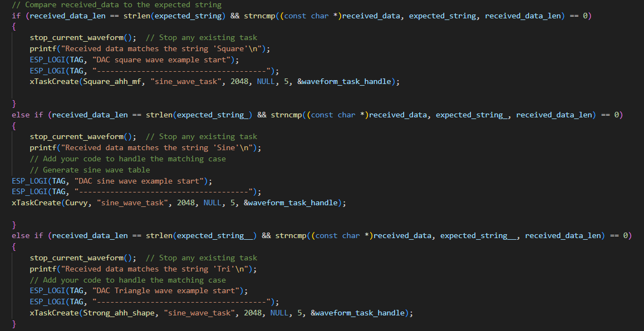
https://drive.google.com/file/d/1HsJdlkcoqY8s2VR6HYMTjCI4jrrvhMAs/view?usp=sharing

Slide 9
Oscilloscope and Multimeter
Peter Zhang
Accomplishments since last update 24 hrs of effort | Ongoing progress/problems and plans until the next presentation
Tested ammeter, ohmmeter, and voltmeter readings Integrated oscilloscope functionality | Validate multimeter and oscilloscope Complete system testing Evaluate multimeter corner cases Test oscilloscope readings

Slide 10
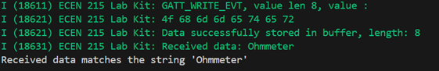
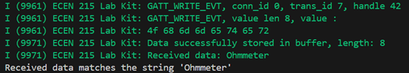
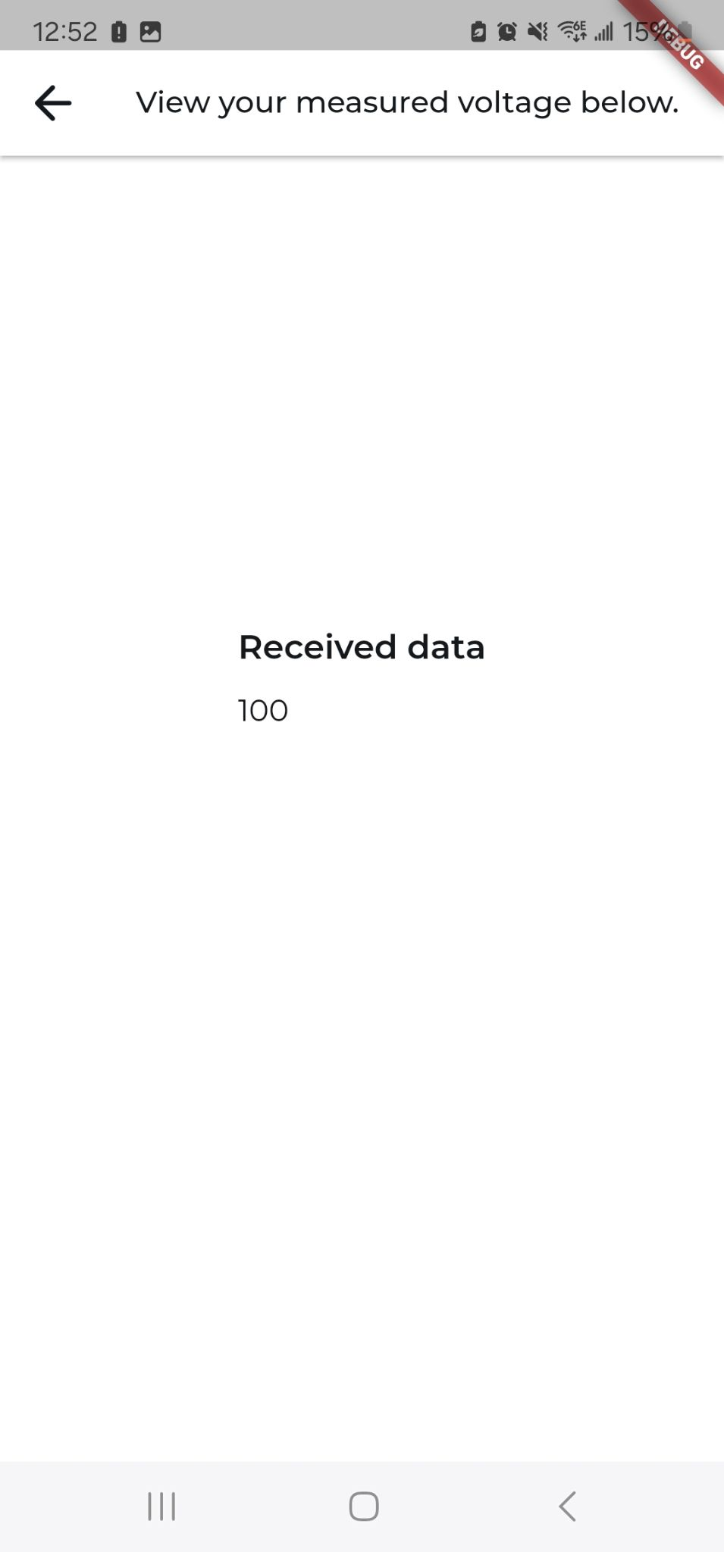
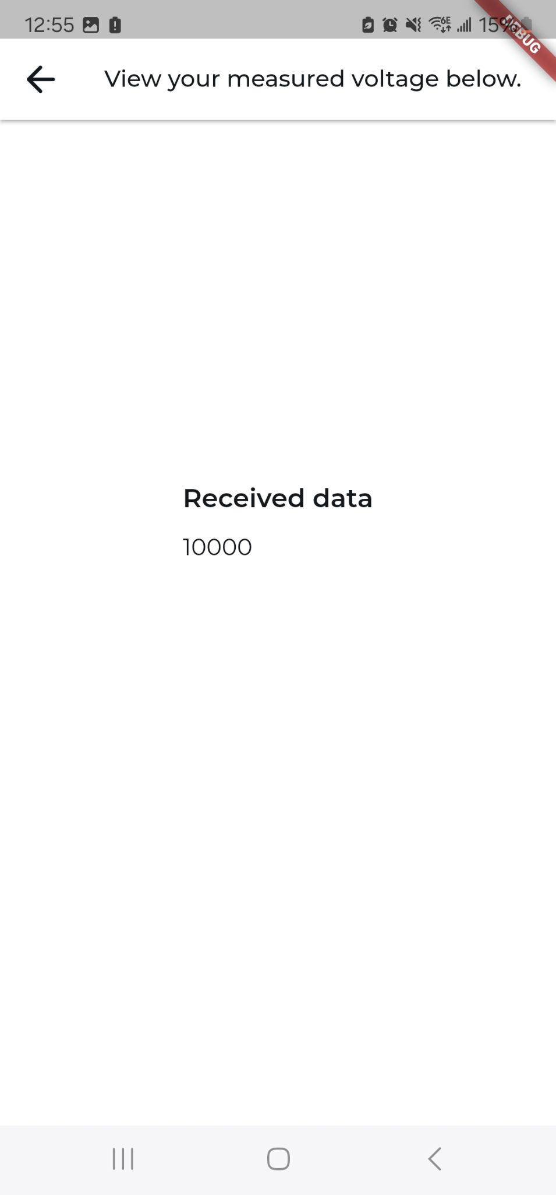
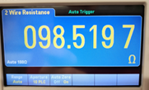
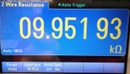

Slide 11
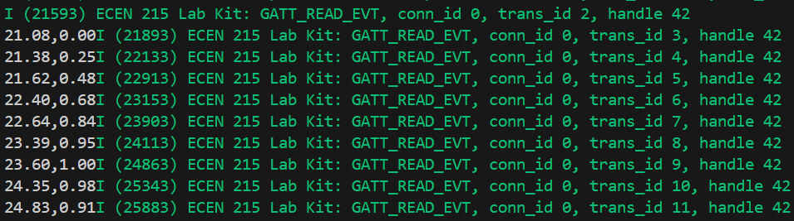
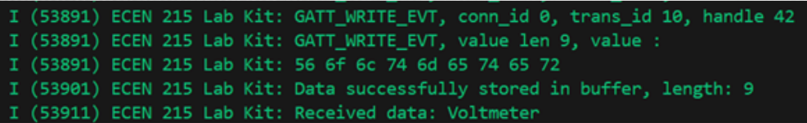
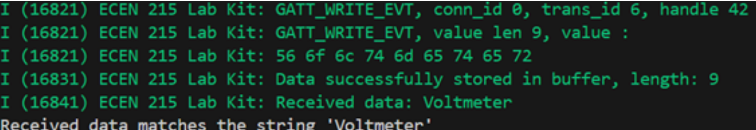
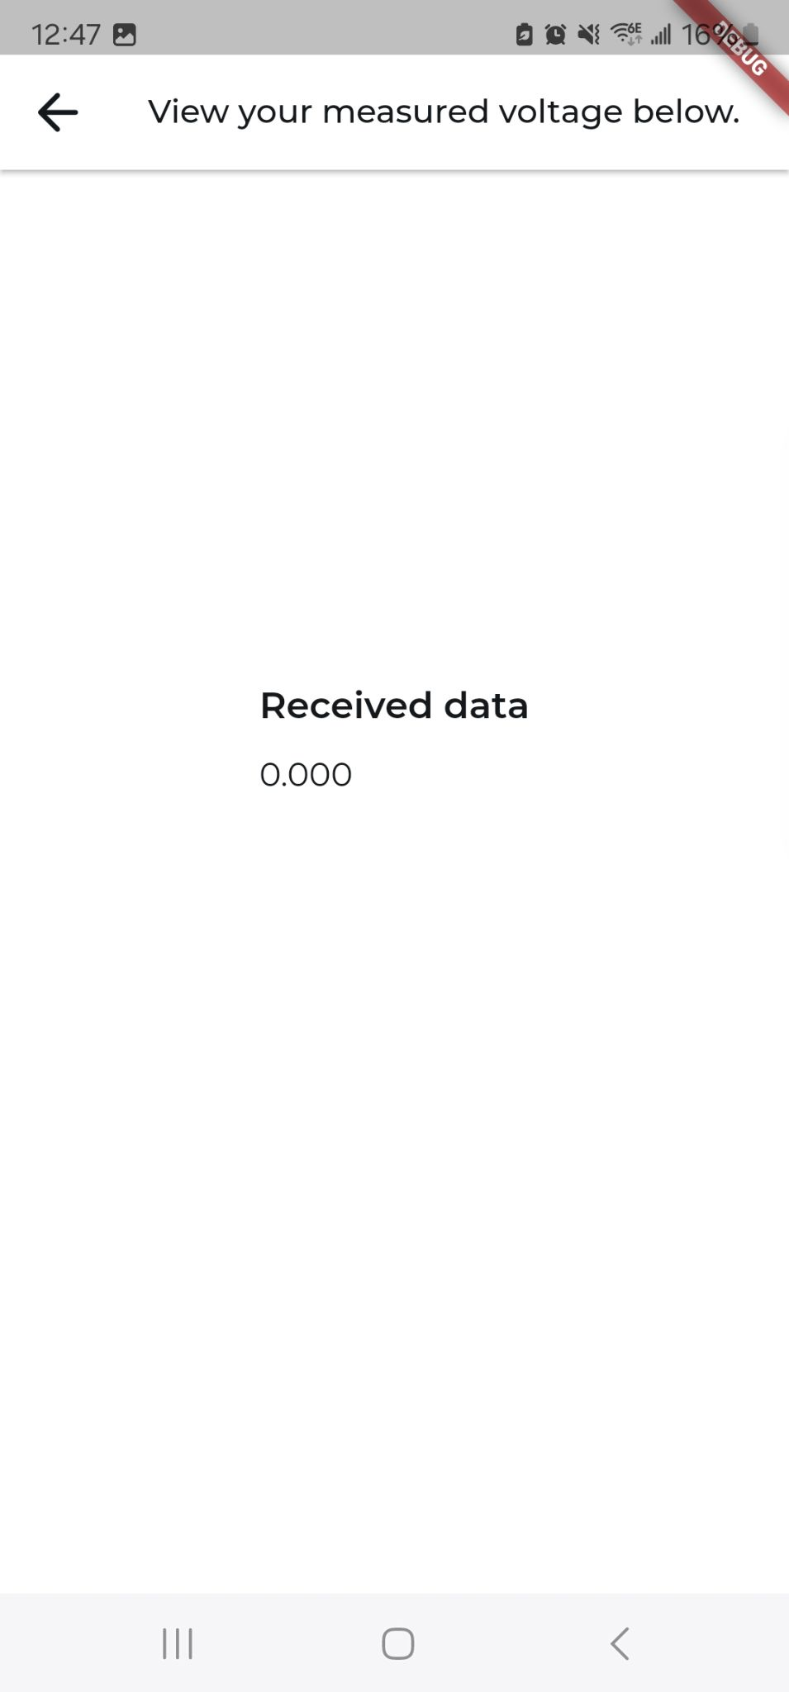
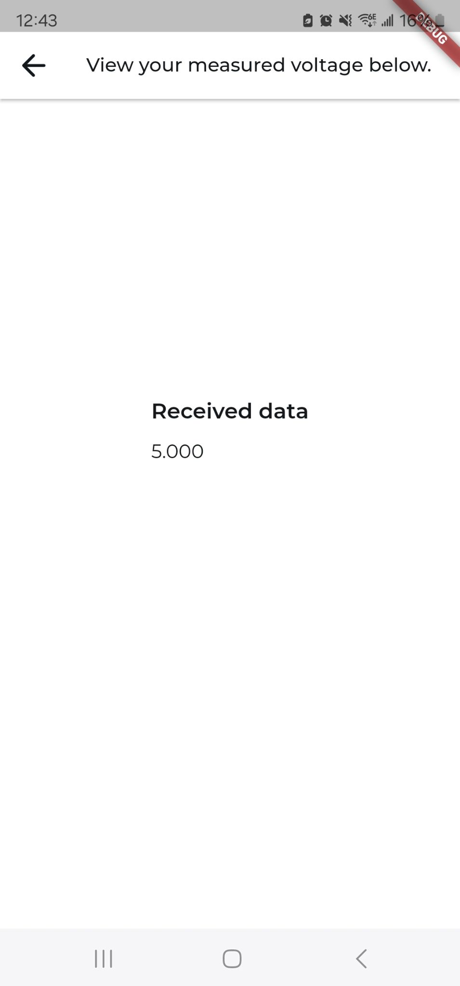
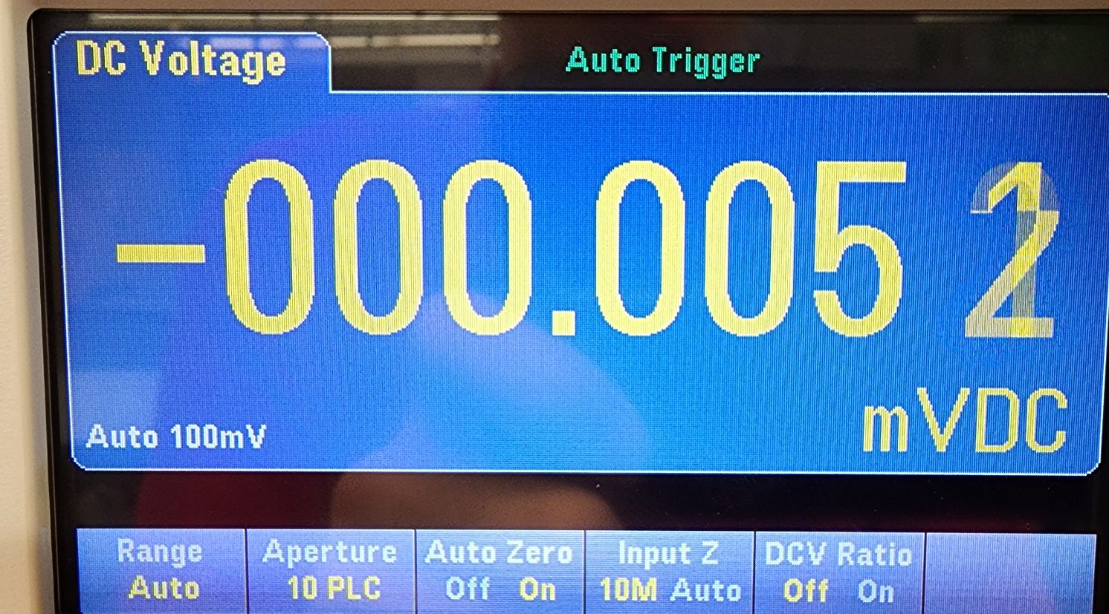
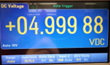

Slide 12
Mobile App
Luis Diaz-Santini
Accomplishments since last update 35 hrs of effort | Ongoing progress/problems and plans until the next presentation
Waveform generator produces less noise App creates “graph” with data received from ESP32 Subtle aesthetic updates to app | Solve (potential) memory issue with ESP32 Debug Oscilloscope graph Test all system functionality using application

Slide 13
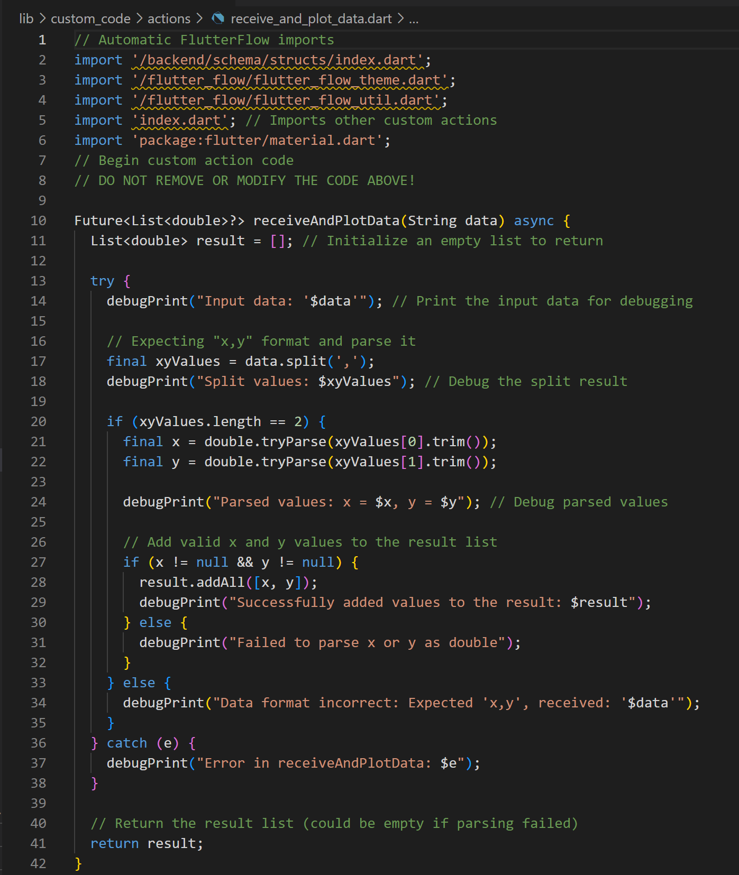

Slide 14
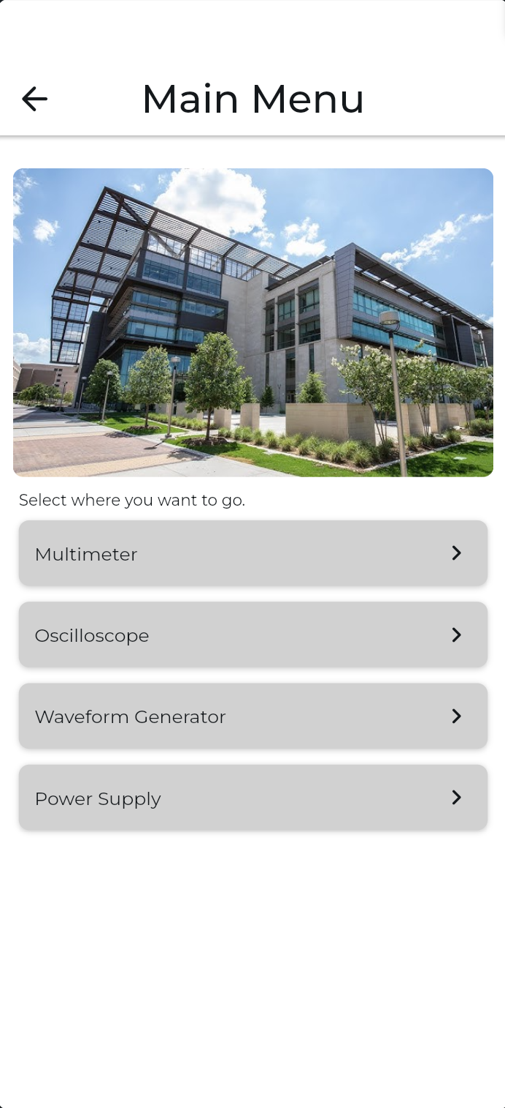
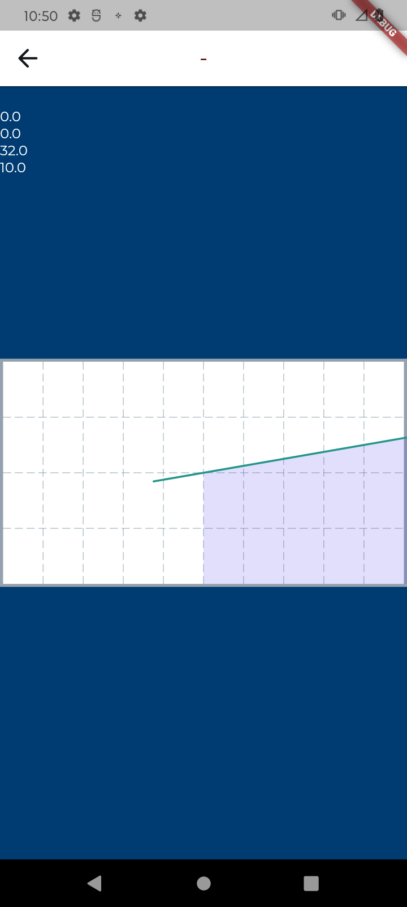
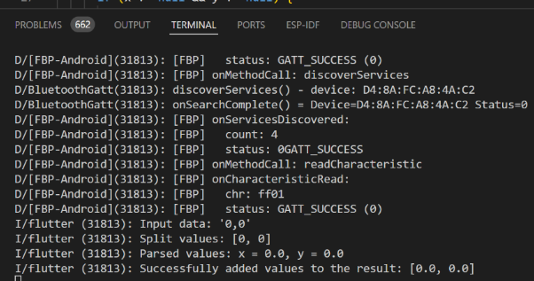

Slide 15
PCB and Power
Ryan Freed
Accomplishments since last update 61 hrs of effort | Ongoing progress/problems and plans until the next presentation
Assembled final PCB model Successfully integrated 3.3 V buck converter on final design | Determine location of 5 V buck short Upload final code to ESP Test ADC Add capacitor to Wavegen to enable negative voltages

Slide 16
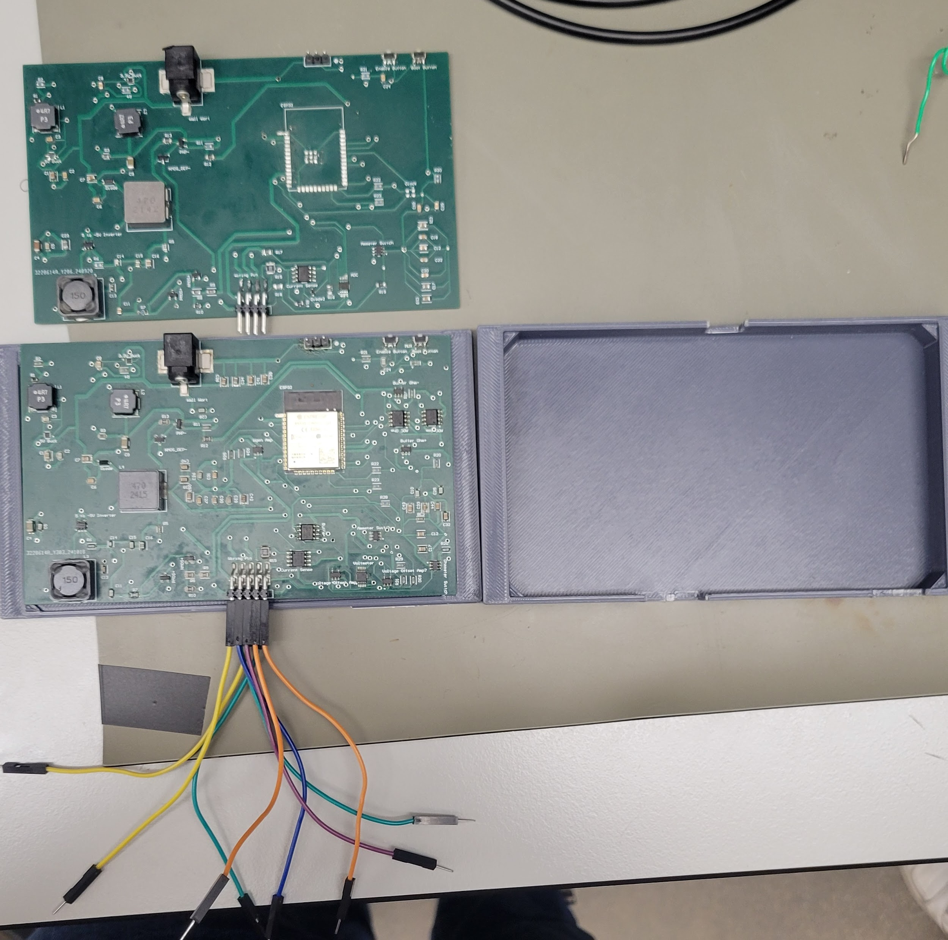

Slide 17
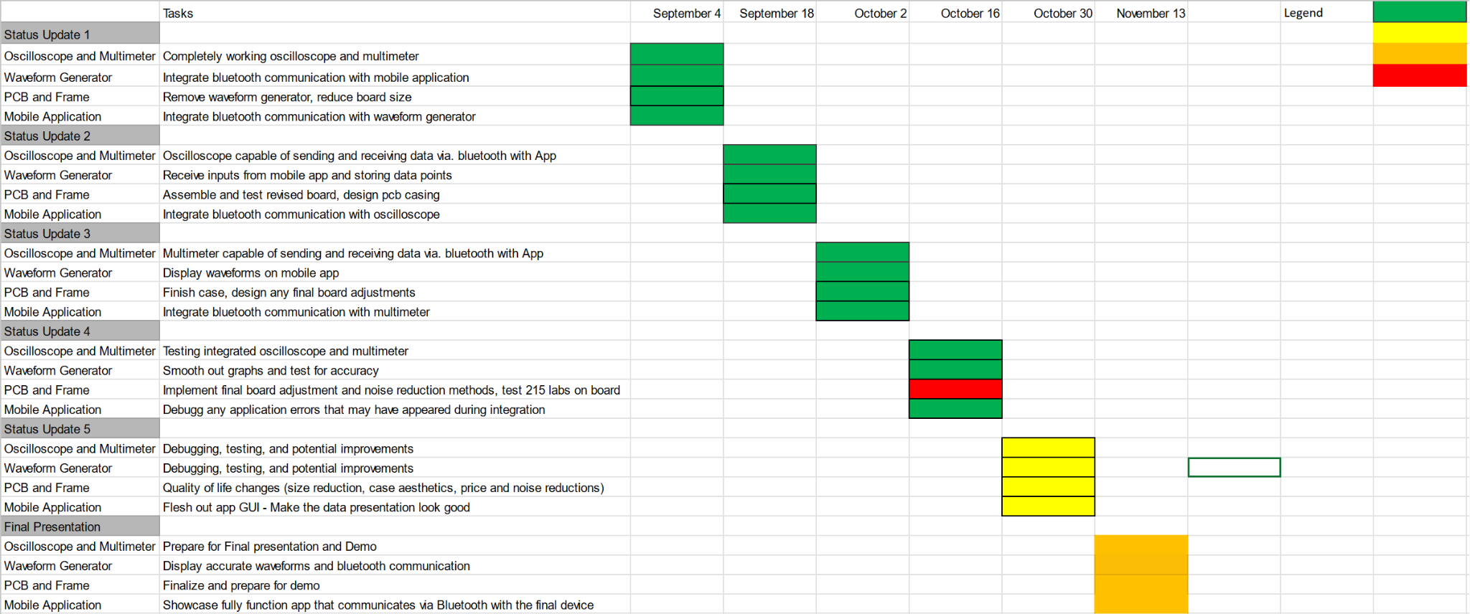
Execution Plan
Notes:
Michelle

Slide 18
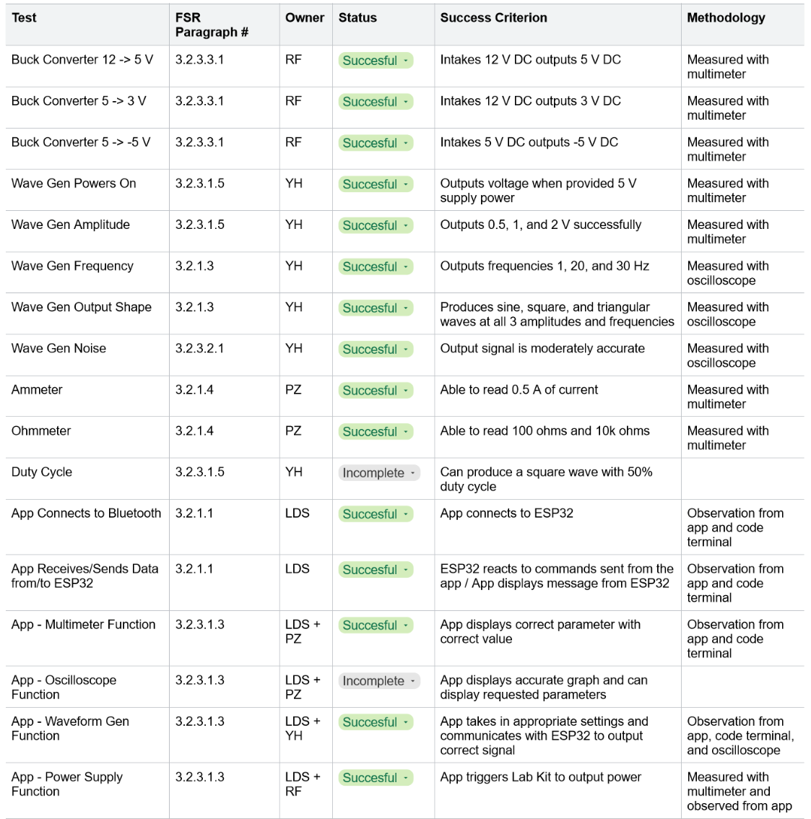
SYSTEM Validation Plan
Notes:
Michelle

Slide 19
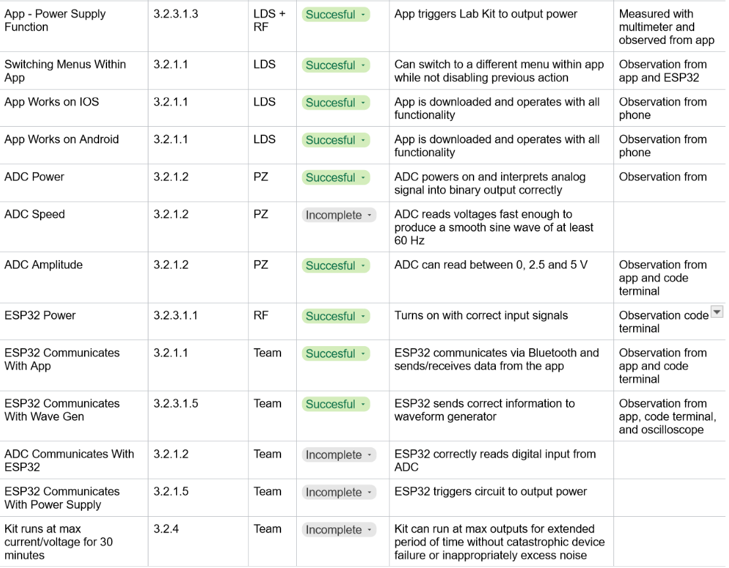
SYSTEM Validation Plan
Notes:
Michelle

Slide 20
Thank you

